Slide 1
Time Speed and distance
csat
Mrs. Munesh , Faculty Abhipedia

Slide 2
Speed Time and distance
Speed
The rate at which a body or an object travels to cover a certain distance is called speed of that body.
Speed is the distance covered by an object in unit time.
Time
The duration in hours, minutes or seconds spent to cover a certain distance is called the time.
Distance
The length of the path travelled by any object or a person between two places is known as distance.

Slide 3
Speed Time and distance

Slide 4
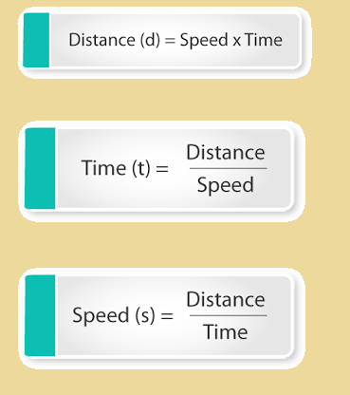
Time & distance formulas
Note: Remember, units of speed, time and distance should be in the same metric system

Slide 5
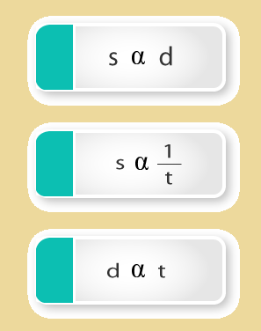
relationship b/t Speed, Distance and Time.

Slide 6
MEASUREMENT AND CONVERSION
1km=1000m
1 hour=60 min
1 minute=60 sec
1 hour=3600 sec

Slide 7
Convert km/h into m/sec
2. Convert m/sec into km/h

Slide 8
Q.1 A person covers a certain distance with a speed of 18 km/h in 8 hours. If he wants to cover the same distance in 6 hours, what should be his speed?

Slide 9
Q.2 A person covers a distance of 12 km, while walking at a speed of 4 km/h. How much distance he would cover in same time, if he walks at a speed of 6 km/h?

Slide 10
Relative Speed
When two bodies A and B are moving with speed a km/h and b km/h respectively, then the relative speed of two bodies is
(i) (a + b) km/h (if they are moving in opposite direction)
(ii) (a - b) km/h (if they are moving in same direction)

Slide 11
Average Speed=
Total Distance
Total Time

Slide 12
Q.3 A person covers a distance of 20 km by bus in 35 min. After de boarding the bus, he took rest for 20 min and covers another 10 km by a taxi in 20 min. Find his average speed for the whole journey.

Slide 13

When a certain distance is covered at speed A and the same distance is covered at speed B, then the
Average speed during the whole journey is

Slide 14
Q.4 Shanker covers a certain distance by car driving at 35 km/h and he returns back to the starting point riding on a scooter with a speed of 25 km/h. Find the average speed for the whole journey.

Slide 15
Q.5 A person covers a certain distance by car at a speed of 25 km/h and comes back at a speed of 40 km/h. What is his average speed during his travel?

Slide 16
If a person covers three equal distance at speed of A km/h ,B km/h,C km/h respectively ,then the average speed during the whole journey be

Slide 17
Q.6 If a person covers three equal distances at the speed of 30 km/h, 15 km/h and 10 km/h respectively, then find out his average speed during the whole journey.

Slide 18
If distance P is covered with speed x, distance Q is covered with speed y and distance R is covered with speed z, then for the whole journey,
Average speed=

Slide 19
Q.7 A person covers 20 km distance with a speed of 5 km/h, then he covers the next 15 km with a speed of 3 km/h and the last 10 km is covered by him with a speed of 2 km/h. Find out his average speed for the whole journey

Slide 20
Q.8 Mr. Sharma travels by car and covers 25% of his journey with a speed of 10 km/h, 45% of his journey with a speed of 5 km/h and remaining 30% of his journey with a speed of 15 km/h. What will be the average speed of Mr. Sharma for the whole journey?

Slide 21
A man cover a certain distance with x km/hr & come back with y km/hr. He takes t hrs to go and come back.
Distance=

Slide 22
Q.9 A boy goes to school at 3km/h and return at a speed of 2km/h. if he takes 5hrs. In all. Find the distance from his village.

Slide 23
Q.10 A man travel a certain distance by train @ 25 km/hr and walk back @ 4km/hr. The whole journey took 5hr 48 min. What distance did he travel by train?

Slide 24
Late/early concept
A Man goes a certain distance with X km/hr and he comes back y km/hr . If he takes t hrs more to come back than go. Find the distance.
*diff b/t time

Slide 25
Q.11 A man covers a certain distance from house to office if he travels @30km/hr , then he is late by 10 min but if he travels @ 40 km/hr then he reaches his office 5 min earlier . Find the distance from home to office .

Slide 26
Q.12 A man covers a certain distance by 10 km/hr and becomes 15 min late . But if he travels the same distance with 12km/hr then he becomes 5 min late find the distance.

Slide 27
Q13. A man increases his speed to 7/5 times of his original speed and reaches his office 20 min before to fixed time, then find the usual time taken by him?

Slide 28
Q.14 Starting from his house one day , a student walks @ 2.5 km/hr and reaches his school 6 min late . Next day he increases his speed 1 km/hr and reaches the school 6 min earlier . How far is the school from his house.
A. 1.75 km
B. 2 km
C. 2.5 km
D. 3 km
E. None of these

Slide 29
Q.15 A car travels a distance of 715 km at a uniform speed. If the speed of the car is 10 km/h more, it takes 2 hours less to cover the same distance. The original speed was
A. 50 km/h
B. 55 km/h
C. 65 km/h
D. 60 km/h
E. None of these

Slide 30
Q.16 A man covers a certain distance on scooter and he travels 3 km/hr faster he would have taken 40 min less . But if he decreases his speed 2 km/hr then he becomes 40 min late . Find the distance.
A. 65 km
B. 50 km
C. 40 km
D. 55 km
E. None of these

Slide 31
Q.17 A man travel a certain distance by his car . If he increases his speed 10 km/hr then he would take 1 hr less time. But if he further increase his speed 10 km/hr then he takes further 45 min lesser time. Find the distance.
A. 125 km
B. 60 km
C. 250 km
D. 420 km

Slide 32
Q.18 If a man had walk 20km/hr faster he would have save 1 hr in the distance of 600km. Find his usual speed?
A. 100 km/hr
B. 200 km/h
C. 250 km/h
D. 120 km/h

Slide 33
Thank you

