Slide 1
Mini Mock Test
Upsc epfo(eo/ao+apfc) exam 2023
English
RISHAV PRASHAR ( English Faculty)
Cleared UPSC CDSE for IMA and OTA
AFCAT 6 Times in a Row

Slide 2
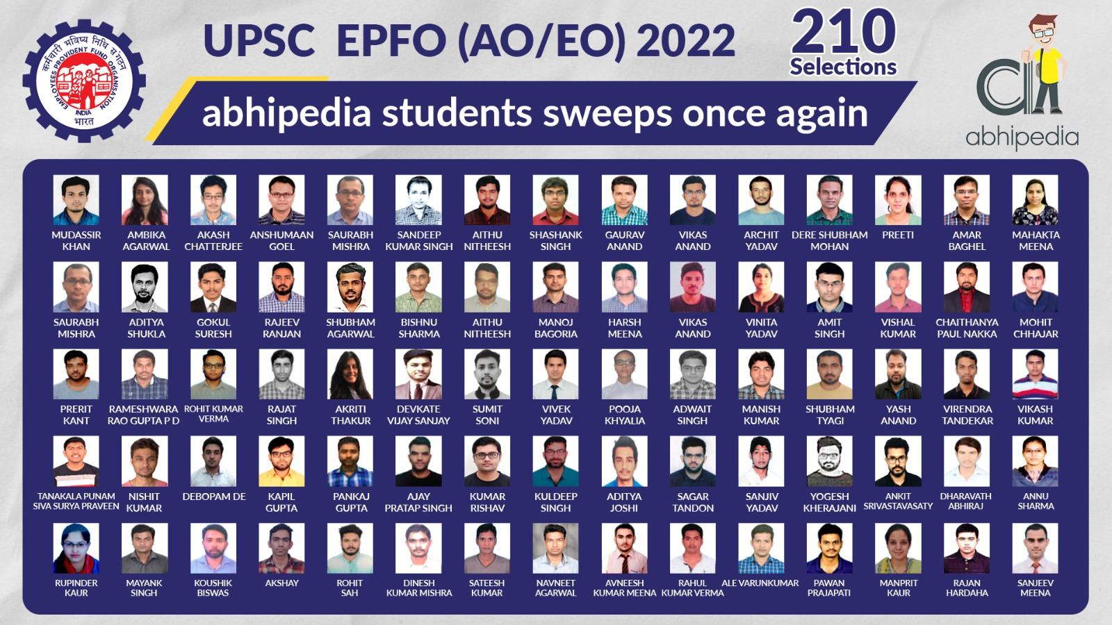

Slide 3


Slide 4
Antonyms 1-3
Salubrious
a) Steadfast
b) Ossified
c) Unhealthy
d) Preposterous

Slide 5
Ans 1
Answer: (c)
Steadfast - Stubborn, Adamant, Headstrong, Mulish, Intransigent, Recalcitrant, Inexorable, Obdurate, Unyielding, Inflexible, Ossified.
Preposterous - Queer, Bizarre, Strange, Weird, Ludicrous, Eccentric, Outlandish.

Slide 6
QUESTION 2
Perturbed
a) Calm
b) Dull
c) Hinder
d) Delight

Slide 7
Ans 2
Answer: (a)
Perturbed - feeling anxiety or concern; unsettled.
Dull - Idle, Passive, Dormant, Inert, Lethargic, Lackadaisical, Torpid, Slothful, Sluggish .
Hinder – Thwart, Foil, Impede.
Delight - Happiness, Ecstasy, Euphoria, Mirth.

Slide 8
QUESTION 3
Lax
a) Apprentice
b) Firm
c) Tenuous
d) Plaintive

Slide 9
Ans 3
Answer: (b)
Lax- Slipshod, Negligent, Remiss, Careless, Heedless.
Tenuous - Insignificant, Unimportant, Trivial, Petty, Insubstantial.
Plaintive – mournful, sad, wistful, doleful, pathetic, pitiful, piteous.

Slide 10
Synonyms 4-5
RESTITUTE
a) repair
b) help
c) revenge
d) avenge

Slide 11
Ans 4
Answer: (c)
Restitute – Retaliate, Exchange, Give Back, Refund.

Slide 12
QUESTION 5
NEMESIS
a) reward
b) punishment
c) adventure
d) victory

Slide 13
Ans 5
Answer: (b)
Nemesis – Punishment, Affliction, Adversary, Opponent, Scourge.

Slide 14
One word substitution 6 - 8
To free someone from all blames
a) fling
b) forbid
c) exonerate
d) consolidate

Slide 15
Ans 6
Answer: (c)
exonerate (V.) : pronounce not guilty of criminal charges
consolidate (V.) : unite into one
fling (V.) : throw with force/ recklessness
forbid (V.) : prohibit ; to order somebody not to do something

Slide 16
Question 7
Study of tumors
a) Philology
b) Cytology
c) Numismatics
d) Oncology

Slide 17
Ans 7
Answer: (d)
Philology - the study of written records, their authenticity etc.
Cytology – Study of cells.
Numismatics : the study of coins and metals

Slide 18
QUESTION 8
One who does or studies without seriousness.
a) diligent
b) deliberate
c) distracted
d) dilettante

Slide 19
Ans 8
Answer: (d)
dilettante (N.) : a person who does or studies something but is not serious about it and does not have much knowledge
diligent (Adj.) : showing care and effort in your work/duties
deliberate (Adj.) : carefully thought out in advance ; unhurried and with care and dignity

Slide 20
Sentence improvement 9-10
Mrs. Madhuri has great respect and unlimited faith in her Director.
a) respect and unlimited faith for
b) respect for and unlimited faith for
c) respect for and unlimited faith In
d) respect in and unlimited faith for

Slide 21
Ans 9
Answer: (c)

Slide 22
QUESTION 10
We have no less than a thousand students in our College.
a) not less
b) no less
c) no fewer
d) No improvement

Slide 23
Ans 10
Answer: (c)

Slide 24
Thank You

