Slide 1
VOCABULARY WORDS
SSC exam
English
RISHAV PRASHAR ( English Faculty)
Cleared UPSC CDSE for IMA and OTA
AFCAT 7 Times in a Row

Slide 2
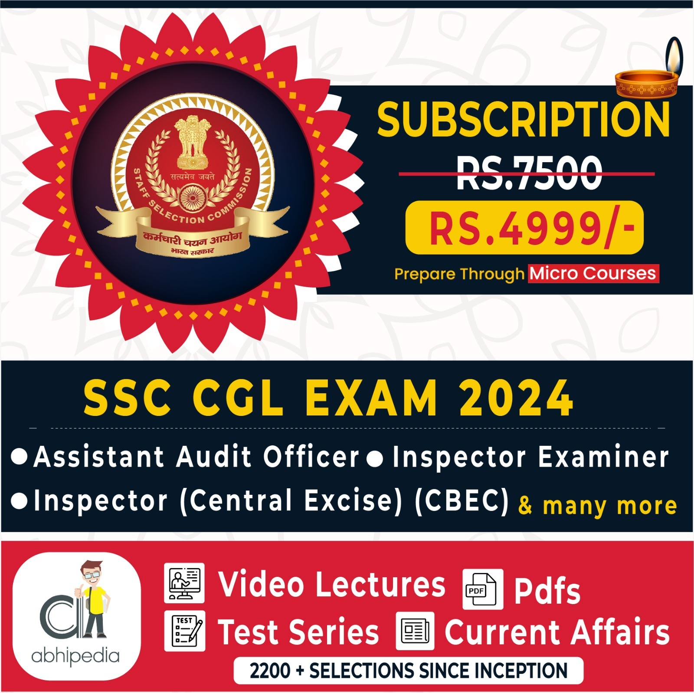

Slide 3


Slide 4
Vocabulary words
1) Covenant ( अनुबंध, प्रतिज्ञापत्र )
Syno - Contract, Accord, Pact, Agreement, Treaty, Promise
2) Gruff ( ककक श, रूखेआचरण वाला)
Syno – Rough, Harsh, Throaty, Rasping
3) Ravage ( तवनाश, बबाकद कर देना)
Syno - Demolish, Destroy, Ruin, Devastate
4) Propitiate (रूठे हुए को मना लेना )
Syno - Appease, allay, alleviate, assuage, placate, satisfy

Slide 5
Synonyms
5) Premonition
Syno - Foreboding, presage, forewarning, prognostication, intuition, hunch, augury.
6) Dilate
Syno - Enlarge, widen, amplify, expand
7) Torpid
Syno - Dull, Inactive, lethargic, idle, quiescent, sleepy

Slide 6
8) Knavish
Syno - Unscrupulous, dishonest, deceitful, conniving, crafty, cunning
9) Laconic
Syno - Brief, concise, terse, succinct, gruff, brusque, reticent, reserved, taciturn, gnomic
10) Uncouth
Syno - Coarse, ill-bred, awkward, boorish, churlish, cheap, unprincipled

Slide 7
11) Decimated
Syno - Destroyed, exterminated, demolished, annihilated, desolated, obliterated
12) Decimated
Syno - Destroyed, exterminated, demolished, annihilated, desolated, obliterated
13) Apposite
Syno - Appropriate, apt, pertinent, relevant, germane, suitabl

Slide 8
14) Indignation
Syno - Anger, annoyance, fury, ire, resentment, umbrage, rage, outrage, irateness
15) Abysmal
Syno - dreadful, abominable, awful, terrible , profound, extreme, unfathomable, bottomless, complete, utter
16) Flair
Syno - Talent, aptitude, knack, gift , style, panache, verve , mastery

Slide 9
17) Rout
Syno - Defeat, retreat, crush , state of wild confusion, discomfit
18) Flimsy
Syno - Insubstantial, slight, fragile, wobbly, frail, diaphanous, very thin, weak
19) Perquisite (Noun)
Syno - Privilege, gain, profit, profit incidental to regular salary or wages, perk, bonus, extra

Slide 10
20) Execrate (Verb)
Syno - Curse, swear, abhor, abominate, denounce
22) Poignant (Adj)
Syno - Emotional, sad, heartbreaking, disturbing, heart rending, sentimental
23) Preponderance (Noun)
Syno - Dominance, Supremacy, Noteworthiness, the largest part or the greatest amount

Slide 11
Thank You

